Slide 1
Lesson 8 - Servo,Buzzer and LED Bricks

Slide 2
Servo
Servo motors are used when the angle of rotation is important.
The servo motors that we have can rotate 180 degrees, if you are using a servo it is important to ensure that it is positioned correctly before attaching anything to it.
The servos connect to the 3V3 side of the explorer hat. The pins on that side of the explorer hat are not protected so you must be careful when using them.
Never connect the servo to 5V because it will damage the servo.

Slide 3
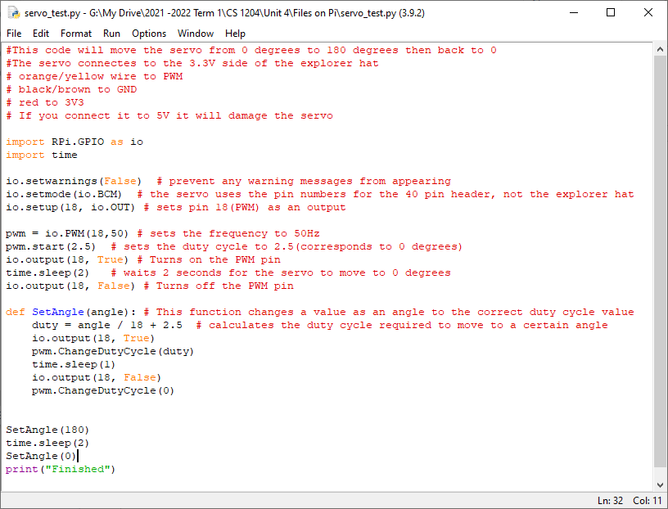

Slide 4
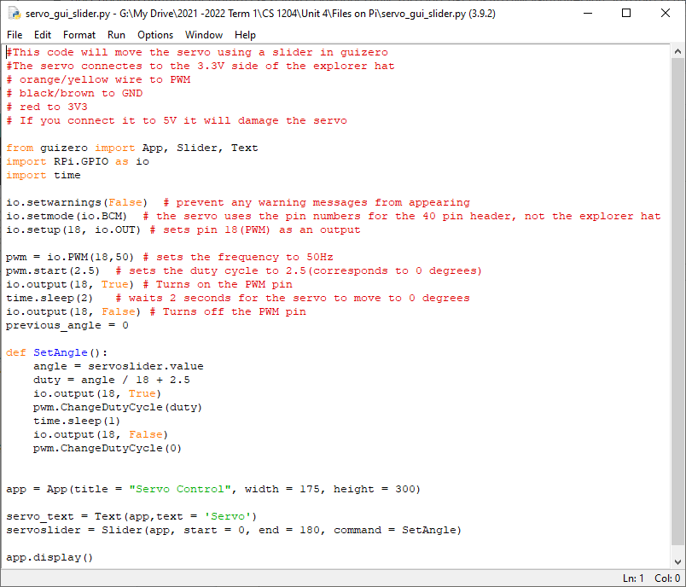
Challenge
Try using the slider in your kit up update the slider value in guizero.
This should also make the servo move.

Slide 5
Buzzers
We have two kinds of buzzers.
Active Buzzer(the one in your kits on the small black circuit boards)
They can only produce one tone. They are connected to 5V and one of the outputs on the explorer hat.
Passive Buzzer(on a white circuit board)
You can control the tone of the buzzer, they connect to the 3V3 side of your explorer hat(like the servo)
More complicated to use(code)

Slide 6
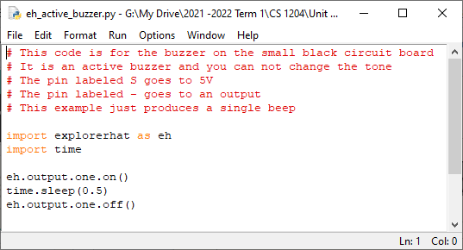

Slide 7
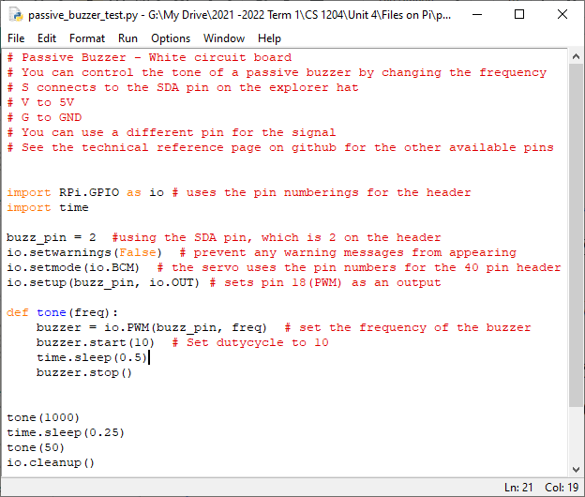

Slide 8
LED Bricks
The led bricks connect to 5V and one of the Outputs. When connecting them you don’t follow the labels on the circuit board
The S pin goes to 5V The G pin goes to one of the Outputs
This is because when you turn on one of the outputs it actually connects to GND instead of 5V. It is done this way to protect the Raspberry Pi.
If you need/want to connect individual leds to your Pi then I will show you how to individually.

Slide 9
